Slide 1

KKR & KSR INSTITUTE OF TECHNOLOGY AND SCIENCES DEPARTMENT OF CSE- ARTIFICIAL INTELLIGENCE
PROJECT TITLE
AI-Powered Pest Control System For Sustainable Agriculture
Team Members:
R.VamsiKrishna(21JR1A43I0)
V.V.M.Sandeep(21JR1A43J6)
P.Giri Babu(21JR1A43H4)
N.Durga Prasad(21JR1A43H0)
Team Guide:
Mrs.K.BhanuSri

Slide 2
CONTENTS:
Abstract
Literature review
Problem statement
Existing solution
Proposed solution
Proposed methodology
References

Slide 3
ABSTRACT
Agriculture faces challenges in pest control, which can cause crop damage and environmental harm.
Traditional pest management methods are often slow and ineffective.
Our project focuses on developing an AI-powered system to help farmers detect and manage pests in real-time.
We use Convolutional Neural Networks (CNN) for image classification to identify pests as harmful or harmless.
The model is trained using pest image datasets from Kaggle to ensure accurate results.
Farmers can upload images and get pest control recommendations through a user-friendly web platform.
The system is deployed on cloud platforms like Heroku or Railway.app for easy access anywhere.
This solution helps farmers protect crops efficiently and supports sustainable farming practices.

Slide 4
Literature Review:
S.NO | Title of the Paper | Author | Journal Name & Year of Publication | Key Findings
1. | PAMICRM:Improving Precision Agriculture Through Multimodal Image Analysis for Crop Water Requirement Estimation Using Multidomain Remote Sensing Data Samples | Ravi Kumar Munaganuri and Yamarthi Narasimha Rao | IEEE,2024 | The model improves crop water estimation and irrigation scheduling. This model improves water estimation and irrigation scheduling.
2. | Analysis of Formal Concepts for Verification of Pests and Diseases of Crops Using Machine Learning Methods | Jamalbek Tussupov, Moldir Yessenova, Gulzira Abdikerimova, Aidyn Aimbetov, Kazbek Baktybekov, Gulden Murzabekova, and Ulzada Aitimova | IEEE,2024 | Machine learning (logistic regression, XGBoost, CNN) is used to detect pests and diseases in crops. Satellite images help reduce pest control costs.
3. | Artificial Intelligence and Internet of Things for Sustainable Farming and Smart Agriculture | Ahmad ali alzubi and Kalda galyna | IEEE,2023 | AI and Iot are being used to improve farming and agriculture. Challenges include managing data and device compatibility.

Slide 5
S.NO | Title of the Paper | Author | Journal Name & Year of Publication | Key Findings
4. | Role of Artificial Intelligence in Agriculture: An Analysis and Advancements With Focus on Plant Diseases | Ruchi rani, jayakrushna sahoo, Sivaiah bellamkonda, Sumit kumar, (member, ieee), and Sanjeev kumar pippal, (member,ieee) | IEEE,2023 | AI techniques like machine learning help detect plant diseases. AI improve disease detection and prediction in agriculture.
5. | Crop Disease Recognition Based on Modified Light-Weight CNN With Attention Mechanism | Yang liu, Guoqin gao, and Zhenhui zhang | IEEE,2022 | A modified lightweight CNN with attention mechanism improve crop disease recognition. Achieved 91.4% accuracy, more efficient than Xception.
6. | IoT-Equipped and AI-Enabled Next Generation Smart Agriculture: A Critical Review, Current Challenges and Future Trends | Sameer qazi, (senior member, ieee), Bilal a. Khawaja, (senior member, ieee), and Qazi umar farooq | IEEE,2022 | IOT and AI improve farming by monitoring crops and saving resources. Challenges exist, but smart agriculture has a bright future.

Slide 6
S.No. | Title of the Paper | Author | Journal Name & Year of Publication | Key Findings
7. | A Systematic Review on Monitoring and Advanced Control Strategies in Smart Agriculture | Syeda iqra hassan , Muhammad mansoor alam 1,3, Usman illahi, mohammed a. Al ghamdi ,Sultan h. Almotiri, and Mazliham mohd su’ud | IEEE,2021 | Smart Farming technologies (IOT, AI, imaging) can solve problems like diseases and water management. Automation improves crop yield and soil fertility.
8. | Big Data and AI Revolution in Precision Agriculture: Survey and Challenges | Showkat ahmad bhat and Nen-fu huang , (senior member, ieee) | IEEE,2021 | AI and Big Data enhance farming productivity and sustainability. Data Analytics improve decision-making for efficient farming.

Slide 7
S.NO | Title of the Paper | Author | Journal Name & Year of Publication | Key Findings
9. | Research on Recognition Model of Crop Diseases and Insect Pests Based on Deep Learning in Harsh Environments | Yong ai, Chong sun, Jun tie, and Xiantao cai | IEEE,2020 | 86.1% accuracy in identifying crop diseases and pests using Inception-ResNet-v2. WeChat app developed for real-time pest and disease recognition with guidance.
10. | An AIoT Based Smart Agricultural System for Pests Detection | Ching-ju chen, Ya-yu huang, Yuan-shuo li, Chuan-yu chang, (senior member, ieee), and Yueh-min huang, (senior member, ieee) | IEEE,2020 | Deep learning model (Inception-ResNet-v2) used for automatic crop disease and pest recognition WeChat app developed for real-time crop disease.

Slide 8
PROBLEM STATEMENT
Agriculture faces significant challenges in pest control, which directly affect crop health and farming sustainability.
Traditional pest control methods often fall short, leading to:
Late pest detection causing crop damage and reduced yields.
Inefficient pest management leading to increased pesticide usage and environmental harm.
Reduced agricultural productivity due to the inability to identify harmful pests in time.
The challenge is to design an AI-powered system that accurately identifies pests in real-time, classifies them as harmful or harmless, and provides actionable recommendations for pest.

Slide 9
Existing Solution
Traditional pest control methods rely on manual detection and treatment, often resulting in delayed identification of pests and inefficient management.
Some pest detection systems use image recognition, but they lack the accuracy and real-time functionality needed for effective pest control in agriculture.
Existing systems are either hardware-dependent or require significant resources, making them impractical for widespread adoption by small-scale farmers.

Slide 10
Proposed Solution
Detects and classifies pests using Kaggle datasets and Convolutional Neural Network (CNN) with ResNet or MobileNet for image classification, optimized with Stochastic Gradient Descent (SGD).
ResNet or MobileNet are used for more efficient and accurate pest detection in real-time, improving model performance.
Provides actionable pest control recommendations through a web interface built with Flask or Gradio.
Deploys the system on cloud platforms like Heroku or Railway.app for easy scalability and accessibility.
Ensures a user-friendly interface for farmers to manage pest control without requiring additional hardware.

Slide 11
Proposed Methodology
Use ResNet or MobileNet models to detect pests in crop images.
Kaggle datasets are used to train the system, ensuring accurate pest detection.
The system gives real-time pest control suggestions based on the detection results.
Built as a web app with Flask or Gradio, making it easy for farmers to use.
The system is hosted on cloud platforms like Heroku or Railway.app for easy access.

Slide 12
DESIGN CONCEPTS
AI for Pest Detection: ResNet or MobileNet models identify pests in images.
Data Source: Trained using pest images from Kaggle.
User Interface: A simple web interface for farmers to upload photos.
Cloud Access: Hosted on cloud platforms for easy access anywhere.
Real-Time Suggestions: Provides instant pest control advice after detection.

Slide 13
DESIGN CONSTRAINTS
Accuracy: The system needs to correctly identify pests from the images.
Data Availability: The model depends on Kaggle pest images, which may not cover all pest types.
Internet Requirement: A stable internet connection is needed for using the web-based system.
Cloud Resources: The system runs on cloud platforms, so it might face some limits on free-tier usage.
Processing Speed: The AI model needs to analyze images quickly for real-time pest detection.

Slide 14
CONCEPTUAL DESIGN
Image Upload: Farmers upload pest-affected crop images through a web interface.
Preprocessing: Images are resized, normalized, and augmented for model compatibility.
Pest Classification: CNN model (e.g., ResNet) classifies pests as harmful or harmless with a confidence score.
Recommendation Generation: Suggests eco-friendly control methods for harmful pests; advises monitoring for harmless ones.
Results Display: Displays pest type, confidence score, and recommendations on a user-friendly interface.
Feedback Collection: Farmers can provide feedback to improve system accuracy over time.

Slide 15
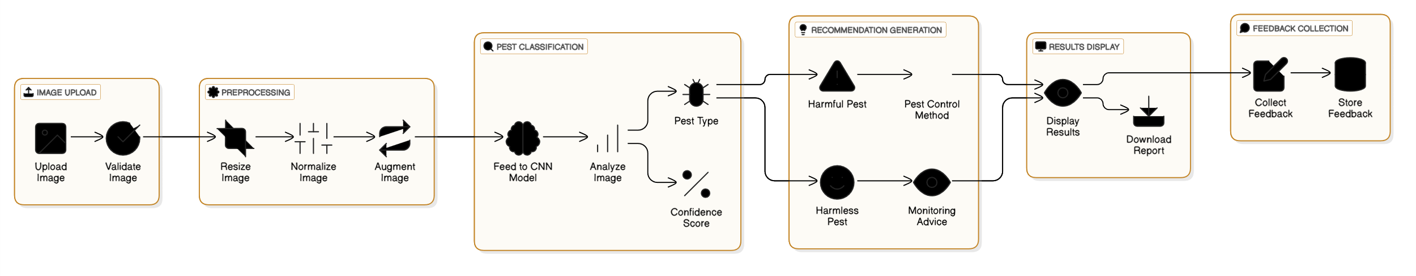
FIG.1 CONCEPTUAL DESIGN

Slide 16
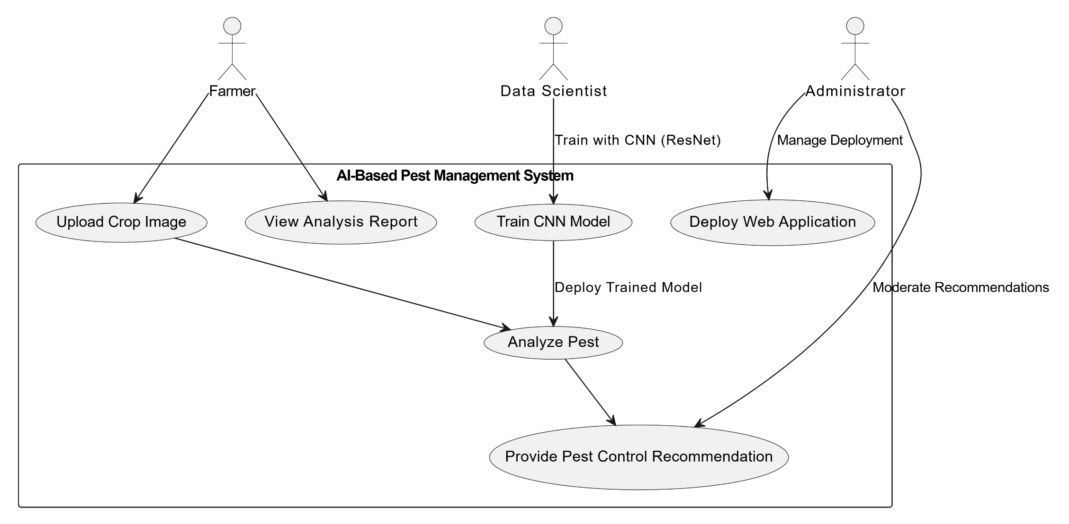
USE CASE DIAGRAM FOR INTERACTIONS
FIG.6

Slide 17
Use Case Diagram
Data Scientist:
Train CNN Model: Uses ResNet to train the AI model for pest classification.
Deploy Web Application: Hosts the system for farmers to use.
View Analysis Report: Monitors system performance and pest data.
Administrator:
Manage Deployment: Ensures the system runs smoothly.
Moderate Recommendations: Reviews and updates pest control suggestions.
Farmers:
Analyze Pest: Uploads pest images for classification.
Receive Recommendations: Gets eco-friendly pest control advice.

Slide 18
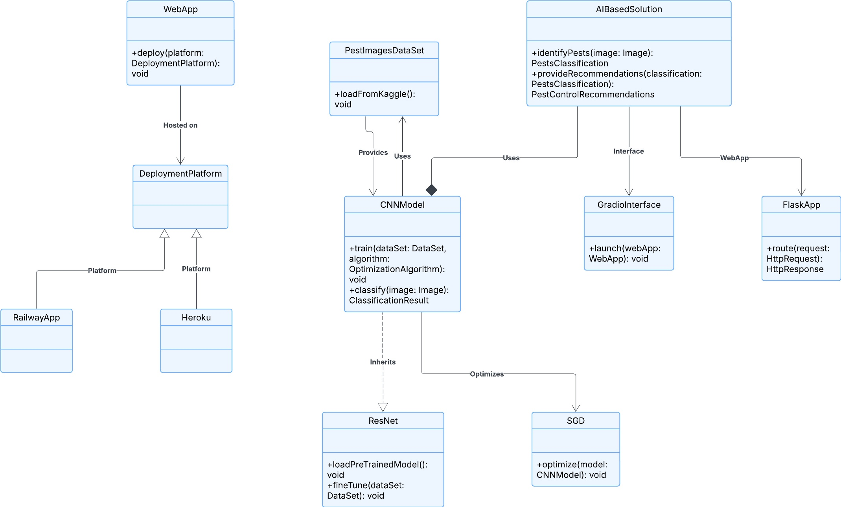
CLASS DIAGRAM CONCEPT
FIG. 4

Slide 19
Purpose: This diagram shows the structure of an AI-based pest control solution.
Main Parts:
WebApp: Deploys the application on platforms like Railway and Heroku.
CNN Model: Handles pest image classification using datasets.
Important Features:
ResNet: An advanced version of CNN for better image classification.
SGD: Optimizes the AI model.
Interfaces: Gradio and Flask are used to interact with the AI solution.
Data: The system uses pest images from a dataset for training the AI model.

Slide 20
LOGICAL DESIGN (LOGICAL DIAGRAMS)
FIG. 8
Logical Design
Start: Focus on sustainable agriculture.
Develop: AI-based pest management system.
Use CNN: For pest classification (harmful or harmless).
Provide Recommendations: Eco-friendly pest control strategies.
Web Platform: Accessible and user-friendly for farmers.

Slide 21
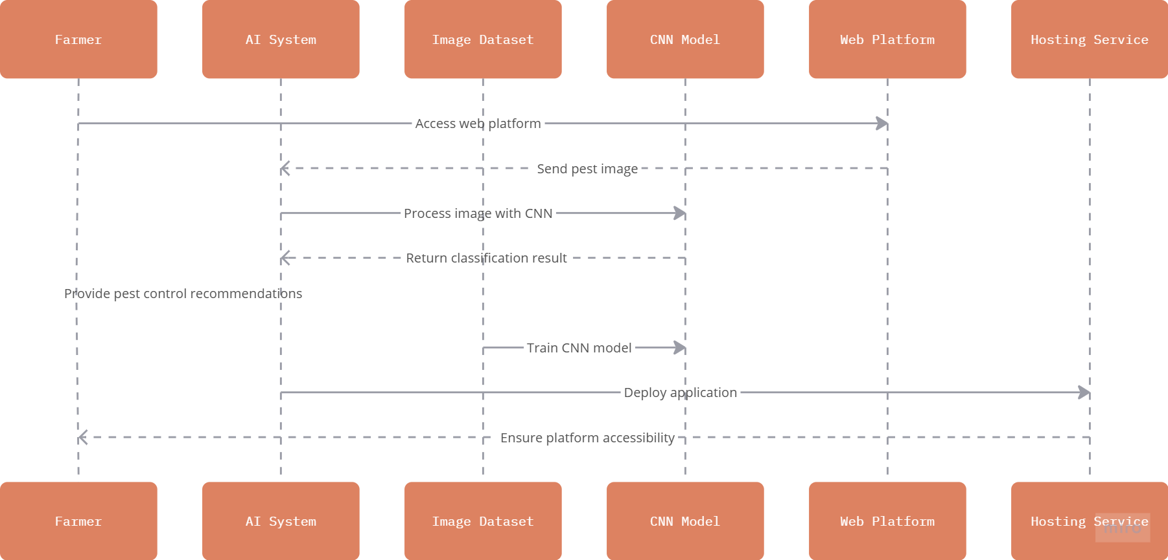
SEQUENCE DIAGRAM FOR STRUCTURE
System Workflow: Farmers access the web platform to upload pest-affected crop images.
The AI system processes the image using a CNN model, classifies the pest, and provides eco-friendly control recommendations.
Key Components: Image Dataset, CNN, ModelWeb, PlatformHosting.
Infrastructure: Hosting services ensure the platform is accessible and scalable for farmers.
FIG. 2

Slide 22
PROCESS FLOW DIAGRAM
FIG. 5
Develop: AI-based web platform for pest control.
Utilize CNNs: Use CNN models (e.g., ResNet) for pest classification.
Train Model: Optimize with Stochastic Gradient Descent using Kaggle dataset.
Classify Pests: Identify pests as harmful or harmless.
Provide Recommendations: Offer actionable, eco-friendly pest control solutions.
Deploy: Host on Heroku or Railway.app for accessibility.
Focus: Real-time pest identification and sustainable pest management.

Slide 23
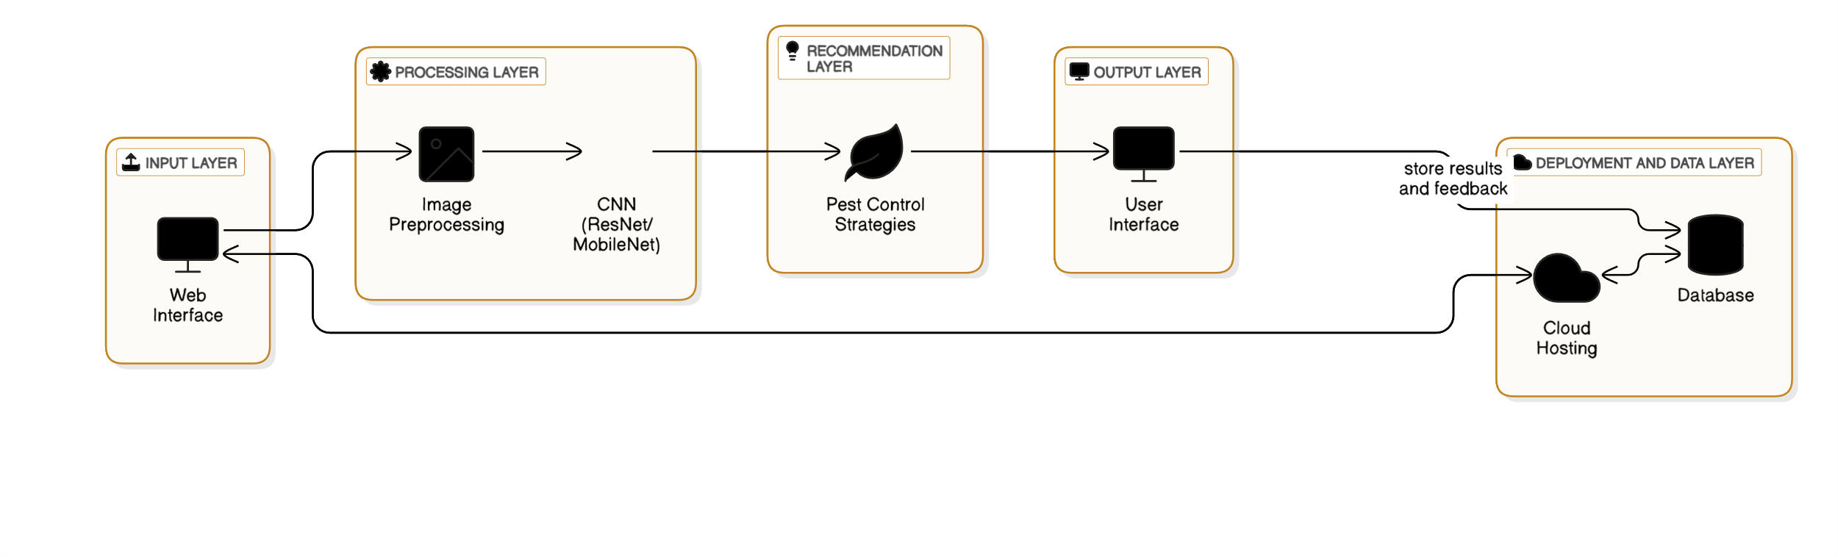
ARCHITECTURAL DESIGN
Architectural Design
Input: Farmers upload pest images via web interface.
Processing: Preprocess images & classify pests using CNN (ResNet/MobileNet).
Recommendation: Generate eco-friendly pest control strategies.
Output: Display results (pest type, confidence, recommendations).
Data Layer: Store results & feedback in a database.
FIG. 3

Slide 24
ALGORITHMS DESIGN (CNN)
Image Preprocessing: Resize the image to 224x224 pixels, normalize pixel values, and expand dimensions for model input.
image = image.resize((224, 224))
image_array = np.expand_dims(np.array(image) / 255.0, axis=0)
Model Inference: Use a pre-trained CNN model (e.g., ResNet) to classify pests and calculate confidence scores.
pest_class = 'Harmful' if np.argmax(predictions) == 0 else 'Harmless’
confidence = np.max(predictions) * 100
Recommendation Generation: Suggest eco-friendly solutions for harmful pests; advise monitoring if pests are harmless.
if pest_class == "Harmful":
recommendation = "Apply neem oil spray and set up pheromone traps."
else:
recommendation = "Monitor crops regularly for early detection."
User Interface Integration: Display results (pest type, confidence score, and recommendations) to the user.
Collect feedback to improve future recommendations.

Slide 25
DATA BASE DESIGN
Database Schema
Tables:
Platform (ID, name, URL).
CNN Model (ID, name, accuracy).
Farmer (ID, name, location).
Dataset (ID, source, image count).
Image (ID, URL, upload date).
Pest (ID, name, classification).
Recommendation (ID, action).
Relationships:
Farmer → Image → Pest → Recommendation.
CNN Model trained on Dataset.
Purpose:
Manages data for pest detection and eco-friendly solutions.

Slide 26
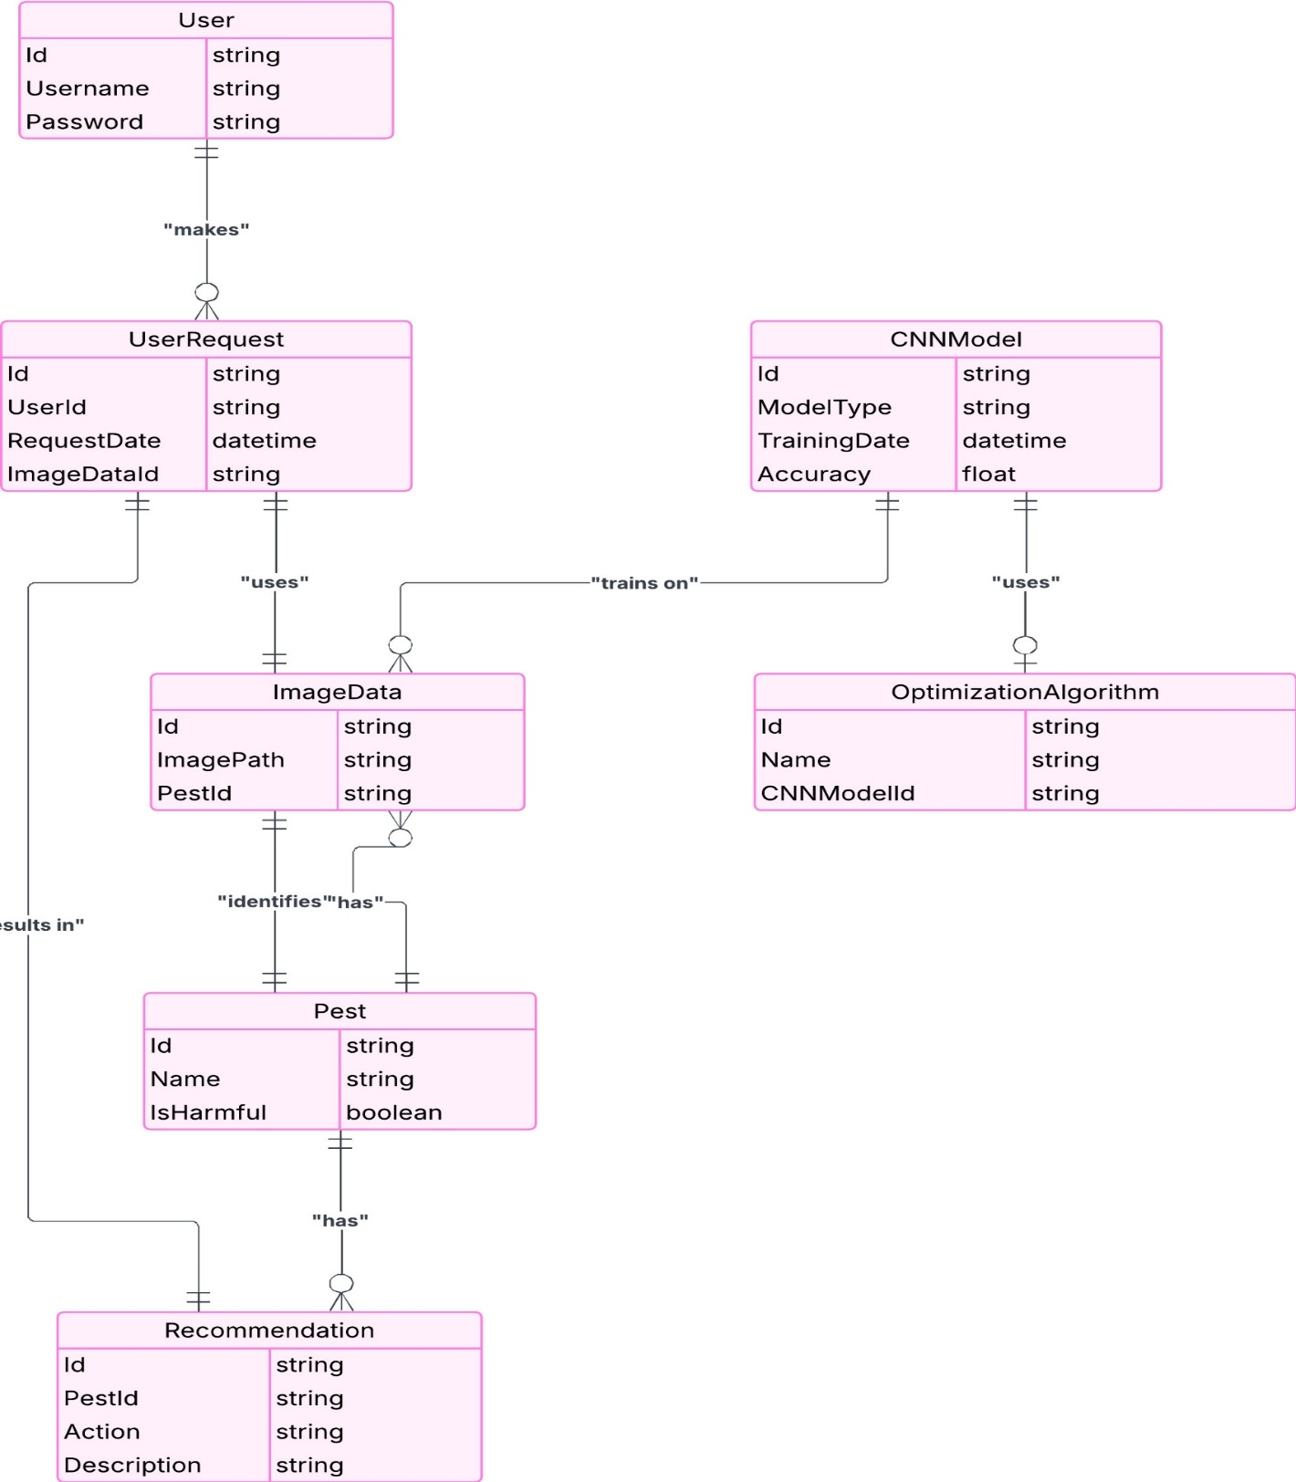
FIG. 7

Slide 27
SAMPLE CODING
from PIL import Image
import numpy as np
import tensorflow as tf
# Preprocess the uploaded image
def preprocess_image(image_path):
image = Image.open(image_path)
image = image.resize((224, 224)) # Resize to fit the model
image_array = np.array(image) / 255.0 # Normalize pixel values
return np.expand_dims(image_array, axis=0) # Add batch dimension
# Load the trained model and classify the pest
def classify_pest(image_array):
model = tf.keras.models.load_model('pest_model.h5') # Load CNN model
predictions = model.predict(image_array)
pest_class = 'Harmful' if np.argmax(predictions) == 0 else 'Harmless'
confidence = np.max(predictions) * 100
return pest_class, confidence
# Generate pest control recommendations
def generate_recommendation(pest_class):
return "Apply neem oil spray." if pest_class == "Harmful" else "No action required."

Slide 28
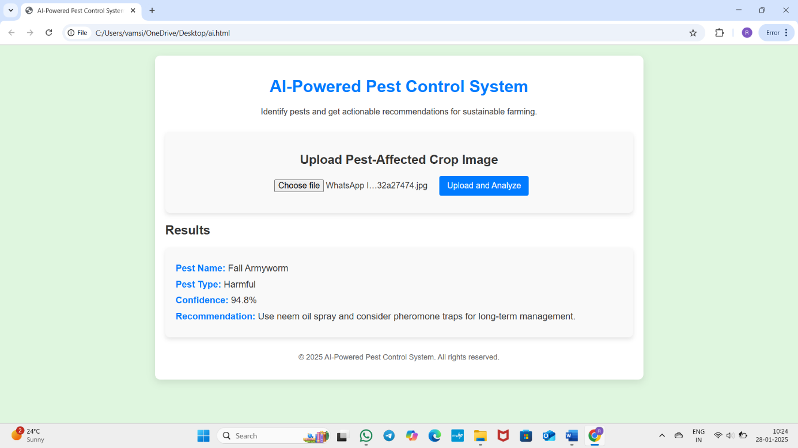
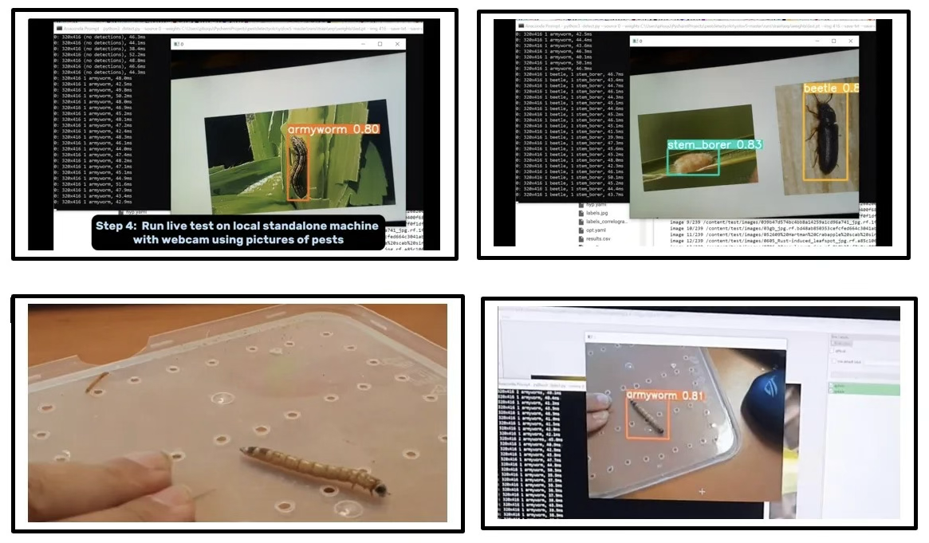
OUTPUT SCREENS
FIG. 9
FIG.10

Slide 29
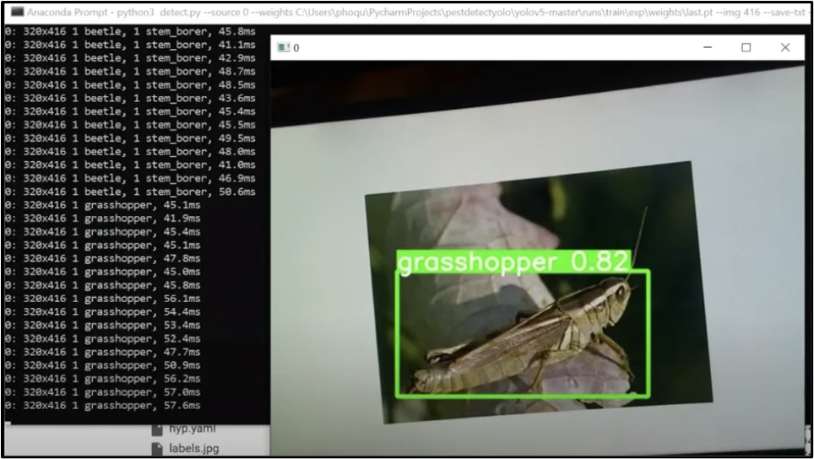
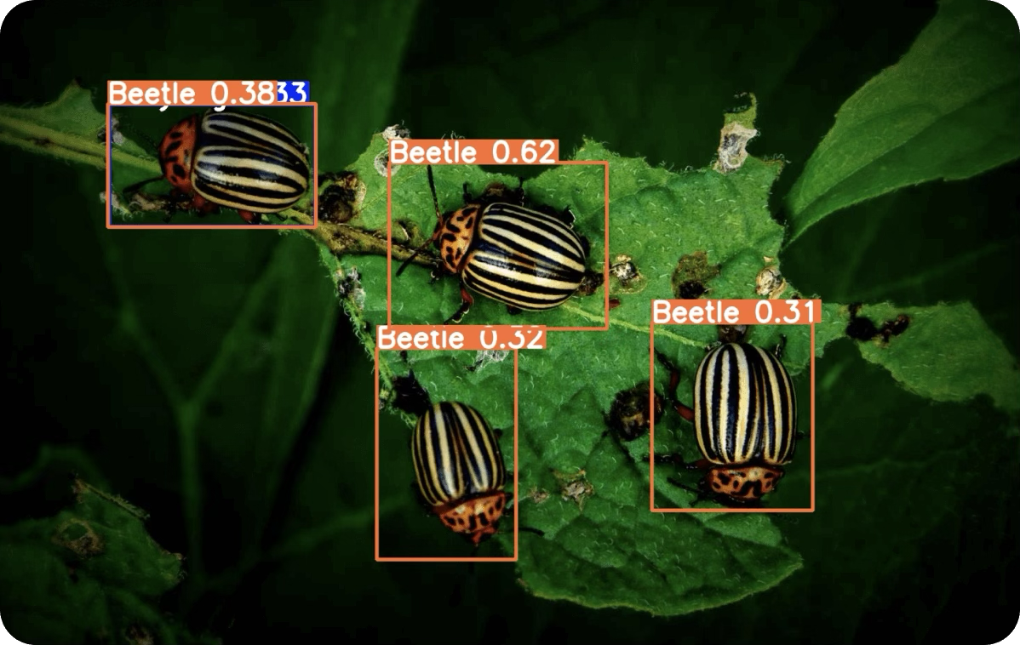
SCREEN REPORTS
FIG. 11
FIG. 12

Slide 30
INTRODUCTION TO TESTING
What is Testing?
Testing is the process of checking whether a software or system works as expected and meets requirements.
Why is Testing Important?
Ensures the software is error-free
Improves reliability and performance
Enhances security and user experience
Types of Testing in Our Project:
Functional Testing – Checks if all features work correctly
Performance Testing – Ensures the system runs smoothly under different conditions
Security Testing – Protects against vulnerabilities

Slide 31
TYPES OF TESTING
1. Functional Testing
Verifies that all features work as expected.
Ensures correct input-output behavior.
Performance Testing
Checks system speed, stability, and response time.
Identifies bottlenecks under heavy usage.
3. Security Testing
Identifies and fixes vulnerabilities to protect data.
Prevents unauthorized access and data breaches.
4. Usability Testing
Ensures the software is user-friendly and easy to navigate.
Improves the overall user experience.
5. Compatibility Testing
Tests if the software works on different devices and browsers.

Slide 32
TEST CASES AND TEST REPORTS
Test Case ID | Test Scenario | Test Steps | Expected Result | Actual Result | Status
TC_01 | Image Upload Functionality | Upload an image of a pest-affected crop | Image should be uploaded successfully | As Expected | Pass
TC_02 | Pest Detection Accuracy | System analyzes the image for pest identification | System correctly identifies the pest type | As Expected | Pass
TC_03 | Suggestion Feature | System provides pest control suggestions | Proper recommendations should be displayed | As Expected | Pass

Slide 33
Test Case ID | Test Scenario | Test Steps | Expected Result | Actual Result | Status
TC_04 | Display Pest Information | System displays detected pest details and pesticide recommendations | Information should be displayed properly | As Expected | Pass
TC_05 | Database Storage | User data is stored in the database | Data should be saved correctly | As Expected | Pass

Slide 34
Implementation process
1. Dataset Collection & Preprocessing
Collected pest images and applied resizing, normalization, and augmentation.
datagen = ImageDataGenerator(rescale=1./255, rotation_range=20, horizontal_flip=True)
2. Model Training (CNN-based Pest Classification)
Used CNN with TensorFlow/Keras to train the model.
model = Sequential([
Conv2D(32, (3,3), activation='relu', input_shape=(224,224,3)),
MaxPooling2D(2,2),
Flatten(),
Dense(128, activation='relu'),
Dense(10, activation='softmax')
])

Slide 35
3. Pest Detection & Recommendation System
System detects pests and suggests pesticides.
prediction = model.predict(img_array)
print("Detected Pest:", pest_classes[np.argmax(prediction)])
Web Application Development
Built a Flask web app for user interaction.
from flask import Flask, render_template, request
app = Flask(__name__)
@app.route('/')
def home():
return render_template('index.html’)
Deployment & Testing
Hosted the system on Heroku/Railway.app for real-time access.
git push heroku main

Slide 36
IMPLEMENTATION STEPS
Step 1: Data Collection & Preprocessing
Collected pest images and applied resizing, normalization, and augmentation.
Step 2: Model Training
Used CNN (Convolutional Neural Network) with TensorFlow/Keras.
Trained the model for accurate pest classification.
Step 3: Pest Detection & Prediction
System analyzes uploaded images and detects the pest species.
Generates accurate pest classification results.
Step 4: Web Application Development
Built a Flask-based web app for user-friendly image upload and results display.
Step 5: Deployment & Testing
Deployed the system on Heroku/Railway.app for real-time use.
Tested for accuracy, performance, and usability.

Slide 37
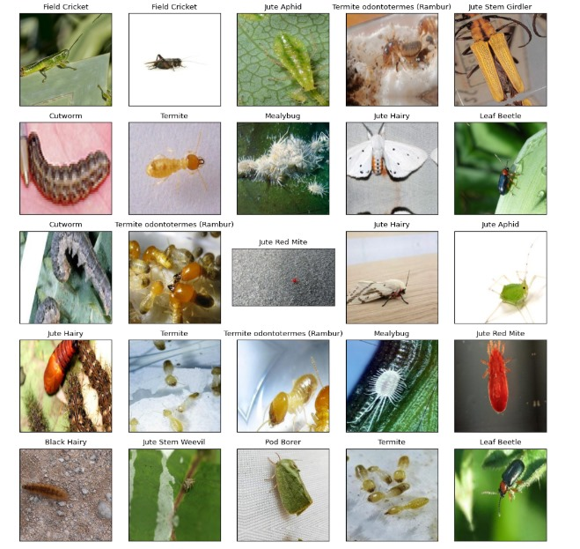
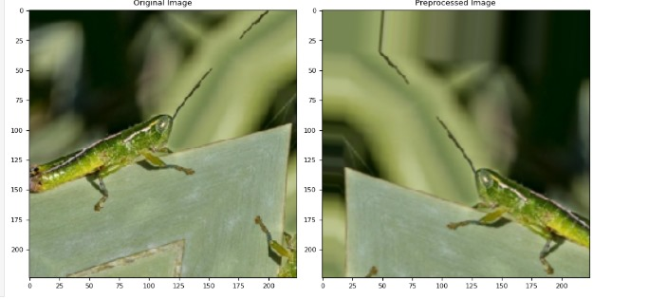
IMPLEMENTATION PROCEDURE
1. Data Collection & Preprocessing
Gathered pest images and applied resizing,
normalization, and augmentation.
2. Data Preprocessing
Resize images for uniformity.
Apply image augmentation techniques like
rotation, flipping, and zooming.
Convert images to numerical arrays.
3. Exploratory Data Analysis (EDA)
Visualize pest distribution using bar graphs.
Identify data imbalances.

Slide 38
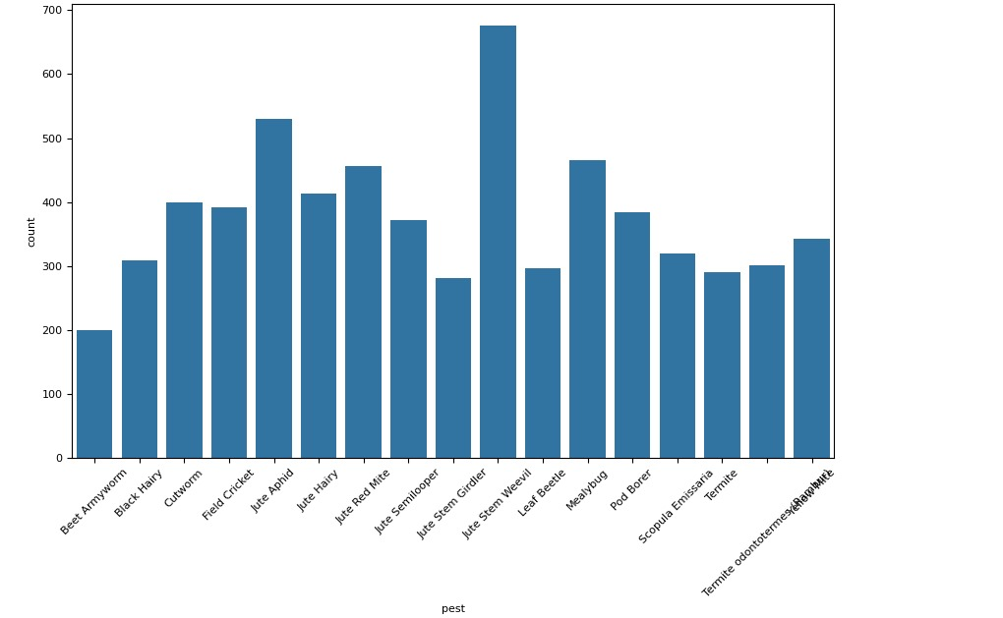
3. Integration into Web Application
Developed a Flask-based web application for easy image upload and pest detection.
4. Deployment
Hosted the system on Heroku/Railway.app for remote access.
5. Testing & Validation
Performed multiple tests to ensure accuracy and reliability.Verified correct pest classification and pesticide recommendations.

Slide 39
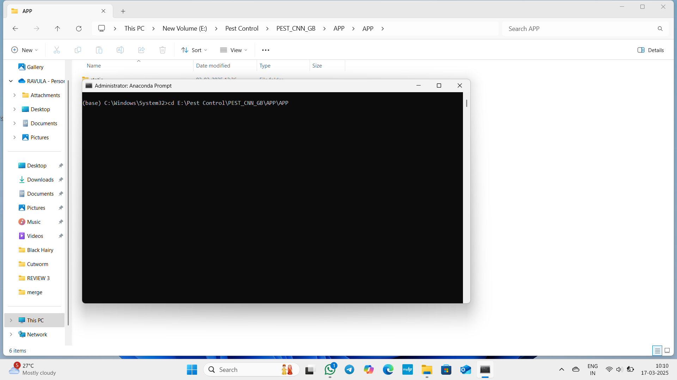
USER MANUAL
Step 1 : open anaconda prompt and run it as administrator.
Step 2 : copy the path dataset and codes/trained images and paste in anaconda prompt as cd path and press enter.
Step 3 : type e: and press enter to change the disk.
Step 4 : type python APP.py and press enter to run the model.
Step 5 : now copy the url as obtained below in anaconda prompt copy it and paste
in browser.

Slide 40
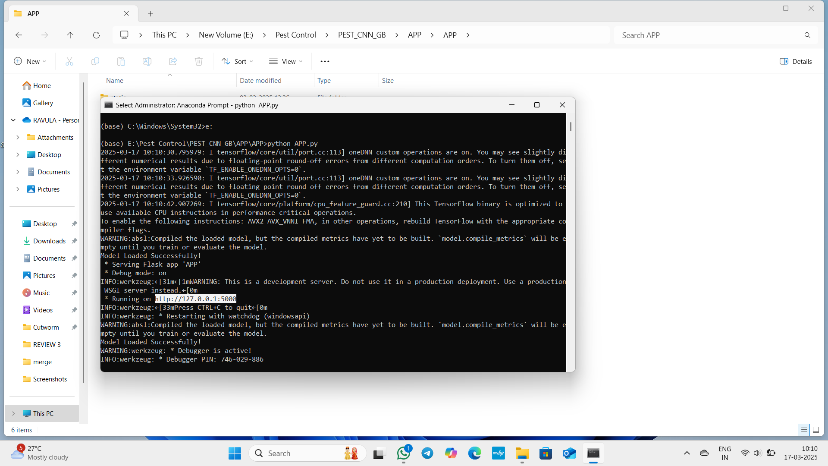
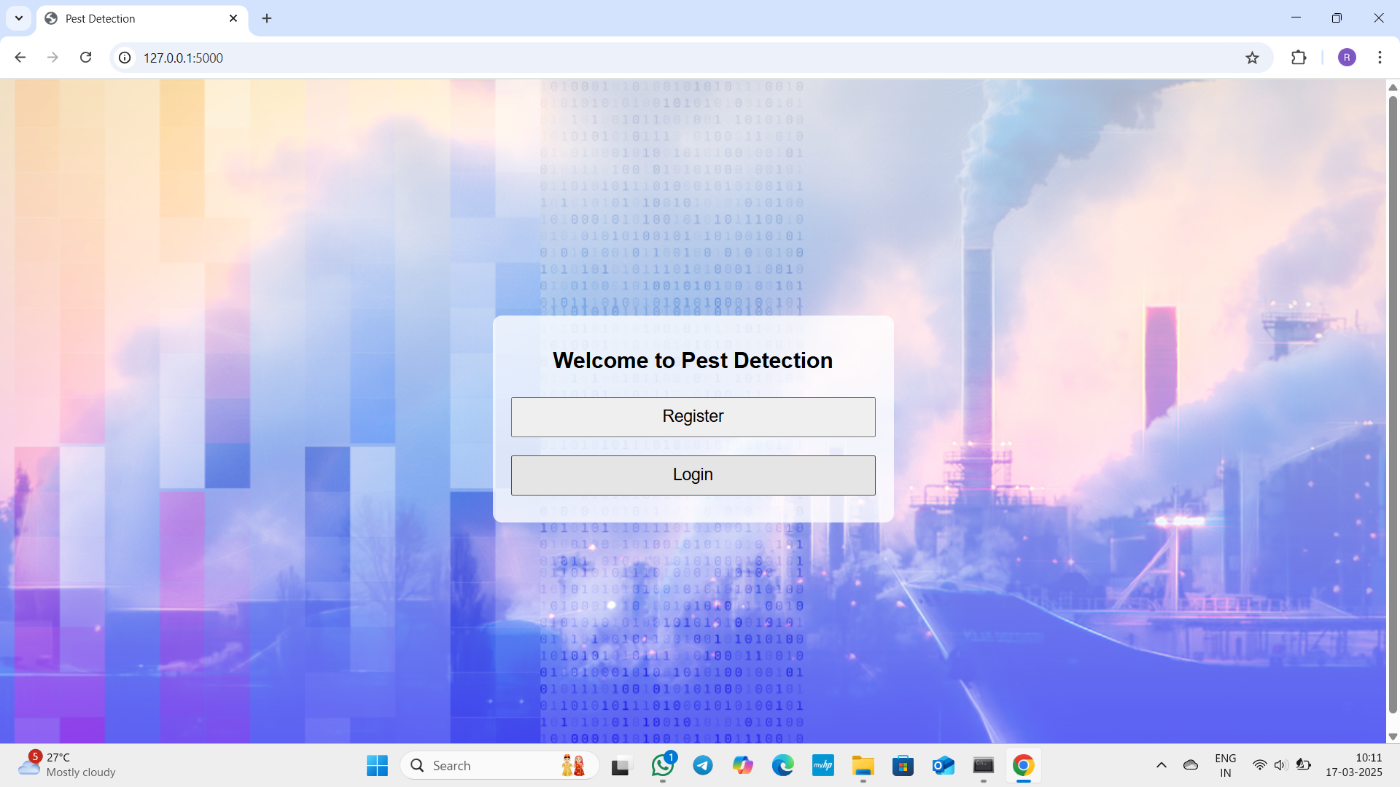
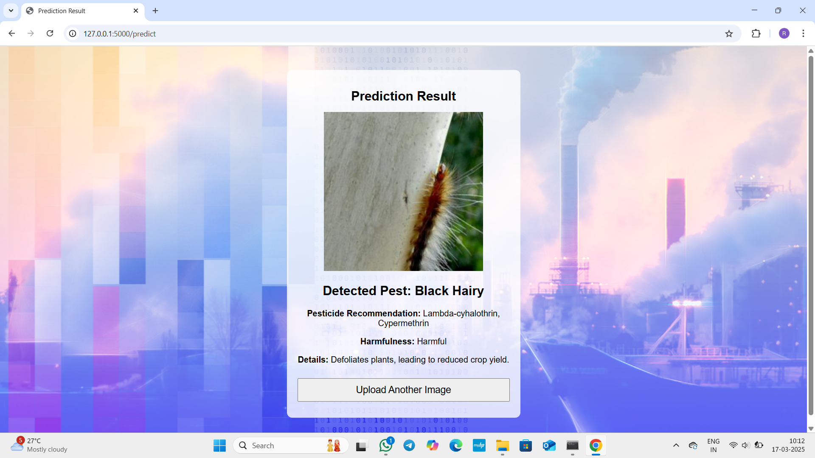
Step 6 : now you get a dashboard in that click register and type username, password and address and register in it.
Step 7 : now login with above registered credentials now you have to upload trained pest images from data in your computer/laptop.
Step 8 : now you will get the predicted result regarding the uploaded pest.

Slide 41
CONCLUSION
The AI-powered Pest Detection System effectively identifies pests using deep learning techniques and provides accurate pesticide recommendations. By leveraging Convolutional Neural Networks (CNNs), the system ensures precise classification of pests and helps farmers take timely preventive actions to protect crops.
The integration of the model into a Flask-based web application makes it user-friendly, scalable, and accessible from any device. The system was trained on a diverse dataset of pest images, ensuring high accuracy in real-world scenarios. Through data preprocessing, model training, testing, and cloud deployment, the project delivers a reliable and efficient pest detection solution.
With deployment on Heroku/Railway.app, the system is accessible for farmers and agricultural experts, promoting smart farming practices. By reducing reliance on manual pest identification and optimizing pesticide usage, this project contributes to sustainable agriculture, improved crop health, and enhanced productivity.

Slide 42
FUTURE ENHANCEMENTS
1. Improved Model Accuracy
Enhance the CNN model with larger datasets and advanced deep learning techniques for better pest identification.
2. Mobile Application Development
Develop a mobile app for farmers to easily upload images and receive real-time pest detection results.
3. Integration with Weather Data
Incorporate weather and environmental data to predict pest outbreaks and recommend preventive measures.
4. Multilingual Support
Add multiple language options to make the system accessible to a wider range of farmers.

Slide 43
BOOKS AND JOURNALS REFERRED
Books
"Deep Learning for Computer Vision" – Rajalingappaa Shanmugamani
Covers CNN architectures used in image classification.
"Machine Learning in Agriculture" – S. Shanmugan
Explores AI techniques in smart farming.
"Artificial Intelligence in Agriculture" – S. Ayyappan & K. Ramasamy
Discusses AI applications in pest detection and precision farming.
Journals & Research Papers
"Deep Learning-Based Agricultural Pest Monitoring" – Focuses on CNN models for pest detection.
"Insect Pest Image Classification Using Deep Learning" – Covers YOLO and Faster R-CNN models.
"Survey on Crop Pest Detection Using AI" – Provides insights into pest classification techniques.

Slide 44
WEBSITES VISITED
1. Kaggle (https://www.kaggle.com/)
Used for collecting pest image datasets to train the AI model.
2. TensorFlow (https://www.tensorflow.org/)
Referred for implementing CNN-based deep learning models for pest detection.
3. ResearchGate (https://www.researchgate.net/)
Accessed research papers on AI-based pest detection and classification.
4. IEEE Xplore (https://ieeexplore.ieee.org/)
Referred for scientific papers on AI applications in agriculture.
5. GitHub (https://github.com/)
Explored open-source projects related to pest classification models.

Slide 45
References
[1] Ravi Kumar Munaganuri and Yamarthi Narasimha Rao, “PAMICRM: Improving Precision Agriculture Through Multimodal Image Analysis for Crop Water Requirement Estimation Using Multidomain Remote Sensing Data Samples”, IEEE transactions, VOLUME 12, 2024, Page No: 52815-52836, Digital Object Identifier 10.1109/ACCESS.2024.3386552
[2] Jamalbek Tussupov, Moldir Yessenova, Gulzira Abdikerimova, Aidyn Aimbetov, Kazbek Baktybekov, Gulden Murzabekova, and Ulzada Aitimova, “Analysis of Formal Concepts for Verification of Pests and Diseases of Crops Using Machine Learning Methods”, IEEE transactions, VOLUME 12, 2024, Page No: 19902-19910, Digital Object Identifier 10.1109/ACCESS.2024.3361046
[3] Ahmad Ali Alzubi and Kalda Galyna, “Artificial Intelligence and Internet of Things for Sustainable Farming and Smart Agriculture”, IEEE transactions, VOLUME 11, 2023, Page No: 78686-78692, Digital Object Identifier 10.1109/ACCESS.2023.3298215
[4] Ruchi Rani, Jayakrushna Sahoo, Sivaiah Bellamkonda, Sumit Kumar, and Sanjeev Kumar Pippal, “Role of Artificial Intelligence in Agriculture: An Analysis and Advancements With Focus on Plant Diseases”, IEEE transactions, VOLUME 11, 2023, Page No: 13799-138019, Digital Object Identifier 10.1109/ACCESS.2023.3339375
[5] Yang Liu, Guoqin Gao, and Zhenhui Zhang, “Crop Disease Recognition Based on Modified Light-Weight CNN With Attention Mechanism”, IEEE transactions, VOLUME 10, 2022, Page No: 112066-112075, Digital Object Identifier 10.1109/ACCESS.2022.3216285

Slide 46
[6] Sameer Qazi, Bilal A. Khawaja, and Qazi Umar Farooq, "IoT-Equipped and AI-Enabled Next Generation Smart Agriculture: A Critical Review, Current Challenges and Future Trends", IEEE transactions, VOLUME 10, 2022, Page No: 21219-21235, Digital Object Identifier 10.1109/ACCESS.2022.3152544
[7] Syeda Iqra Hassan, Muhammad Mansoor Alam, Usman Illahi, Mohammed A. Al Ghamdi, Sultan H. Almotiri, and Mazliham Mohd Su’ud, "A Systematic Review on Monitoring and Advanced Control Strategies in Smart Agriculture", IEEE transactions, VOLUME 9, 2021, Page No: 32517-32548, Digital Object Identifier 10.1109/ACCESS.2021.3057865
[8] Showkat Ahmad Bhat and Nen-Fu Huang, "Big Data and AI Revolution in Precision Agriculture: Survey and Challenges", IEEE transactions, VOLUME 9, 2021, Page No: 110209-110222, Digital Object Identifier 10.1109/ACCESS.2021.3102227
[9] Yong Ai, Chong Sun, Jun Tie, and Xiantao Cai, "Research on Recognition Model of Crop Diseases and Insect Pests Based on Deep Learning in Harsh Environments", IEEE transactions, VOLUME 8, 2020, Page No: 171686-171693, Digital Object Identifier 10.1109/ACCESS.2020.3025325
[10] Ching-Ju Chen, Ya-Yu Huang, Yuan-Shuo Li, Chuan-Yu Chang, and Yueh-Min Huang, "An AIoT Based Smart Agricultural System for Pests Detection", IEEE transactions, VOLUME 8, 2020, Page No: 180750-180761, Digital Object Identifier 10.1109/ACCESS.2020.3024891

Slide 47
Thank You (Any Queries)

